Slide 1

Smart Student Skill Exchange Platform Using Graphs and Hash Tables
CSA0309 – DATA STRUCTURES
PRESENTED BY:
B Sathvika(192525224)
Mahalakshmi(192521155)
Ragavi K (192524394)
Prena M(192524057)
GUIDED BY: Dr. Uma Priyadarsini P.S,
Professor, SIMATS Engineering

Slide 2


ABSTRACT
Develops a smart platform where students can share and learn skills from one another.
Uses Hash Tables to store and retrieve student profiles and skills quickly.
Uses Graphs to connect students based on their skills and learning interests.
Recommends suitable learning partners for effective collaboration and knowledge exchange
Improves peer learning, communication, and skill development through an efficient and user-friendly system.

Slide 3
INTRODUCTION
Many students have useful skills but do not have a proper platform to share or learn them from others.
This project creates a smart platform where students can exchange knowledge and skills with their peers.
Student information and skills are stored using Hash Tables for fast searching and easy access.
Graphs are used to connect students based on their skills and interests, making it easier to find suitable learning partners.
The platform encourages collaboration, improves learning opportunities, and helps students develop new skills efficiently.

Slide 4
OBJECTIVE
To develop a platform where students can share and learn skills from each other.
To store and manage student profiles efficiently using Hash Tables.
To connect students based on their skills and interests using Graphs.
To recommend suitable learning partners for effective skill exchange.
To encourage collaboration, improve knowledge sharing, and enhance student learning.

Slide 5
LITERATURE REVIEW
Sl No | Year | Authors | Title of the Paper | Journal Name | Algorithms | Findings | Drawbacks
1 | 2023 | R. Kumar et al. | Student Skill Sharing System | IEEE Access | Hash Table | Fast profile search. | No recommendation feature.
2 | 2024 | S. Sharma et al. | Smart Skill Exchange Platform | IJERT | Graph | Better student connectivity. | Limited scalability.
3 | 2025 | M. Patel et al. | Peer Learning Recommendation System | IEEE Access | Graph + BFS | Improved skill matching. | No real-time chat.
4 | 2025 | A. Verma et al. | Student Collaboration Platform | Springer | Hash Table + Graph | Quick data retrieval. | Basic user interface.
5 | 2026 | D. James et al. | Mobile-Based SkillSwap Platform | IJISRT | Graph + Matching | Enhances peer learning. | Limited user testing.

Slide 6
PROBLEM IDENTIFICATION AND ANALYSIS
Students often struggle to find classmates who have the skills they want to learn.
There is no centralized platform to share skills and connect students with similar learning interests.
Manual searching for suitable learning partners is time-consuming and inefficient.
Without a proper matching system, many students miss opportunities for collaboration and knowledge sharing.
The proposed system uses Hash Tables for fast student data retrieval and Graphs for intelligent skill-based connections, making the skill exchange process simple and effective.

Slide 7
DATASET USED
Student ID – Unique identification number for each student.
Student Name – Name of the student.
Skills – Skills the student can teach (e.g., Python, Java, C++, UI/UX).
Interested Skills – Skills the student wants to learn.
Department & Year – Academic department and year of study used for better matching.

Slide 8
SOLUTION DESIGN AND IMPLEMENTATION
Hash Table – Stores student profiles, skills, and interests for fast data retrieval.
Graph – Represents students as nodes and skill-based connections as edges.
Skill Matching – Compares available skills with learning interests to find suitable partners.
Recommendation System – Suggests the best students for skill exchange based on graph connections.
Benefits – Provides quick searching, efficient matching, and encourages collaborative learning among students.

Slide 9
MODULE 1 – STUDENT PROFILE MANAGEMENT USING HASH TABLES
Function:
Registers new student profiles.
Stores student details such as Name, ID, Skills, and Interests.
Retrieves and updates student information quickly using a Hash Table.
Features:
Fast profile storage and search.
Easy profile update and management.
Efficient handling of student records.
Outcome:
Provides quick access to student information and forms the foundation for efficient skill matching.

Slide 10
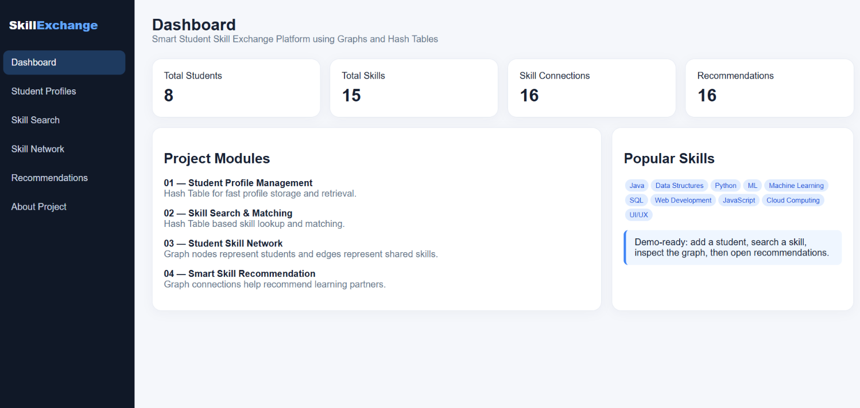
MODULE 1 – STUDENT PROFILE MANAGEMENT USING HASH TABLES

Slide 11
MODULE 2 – SKILL SEARCH AND MATCHING USING HASH TABLES
Function:
Searches students based on their skills and learning interests.
Matches students with suitable learning or teaching partners.
Retrieves matching profiles quickly using a Hash Table.
Features:
Fast skill-based search.
Accurate student matching.
Easy access to relevant profiles.
Outcome:
Helps students quickly find the right partners for skill exchange and collaborative learning.

Slide 12
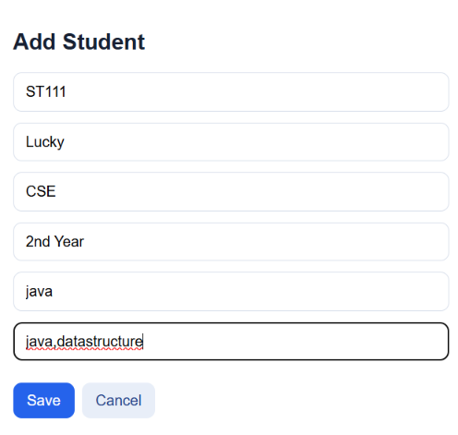
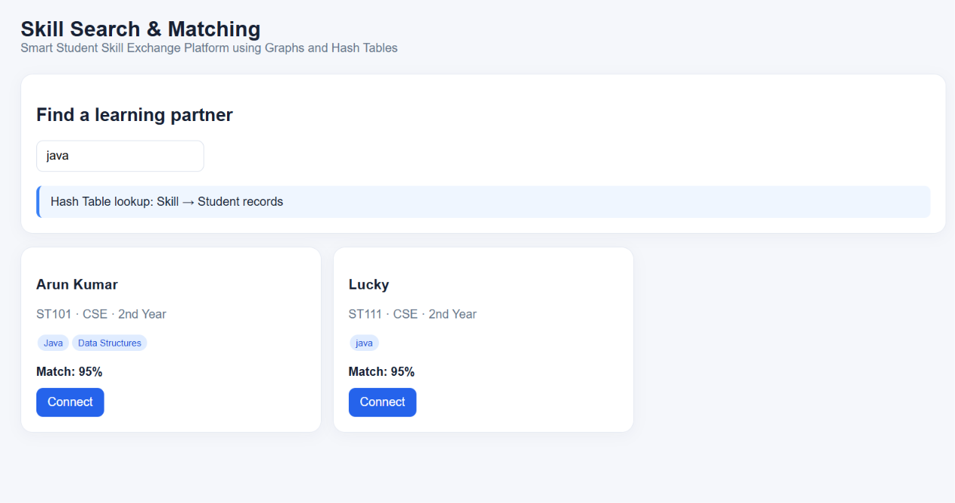
MODULE 2 – SKILL SEARCH AND MATCHING USING HASH TABLES

Slide 13
MODULE 3 – STUDENT SKILL NETWORK USING GRAPHS
Function:
Represents students as nodes and skill connections as edges.
Connects students based on shared skills and learning interests.
Identifies possible learning and collaboration paths.
Features:
Graph-based student connections.
Visual representation of skill relationships.
Easy identification of suitable learning partners.
Outcome:
Creates an efficient student network that promotes skill sharing and collaborative learning.

Slide 14
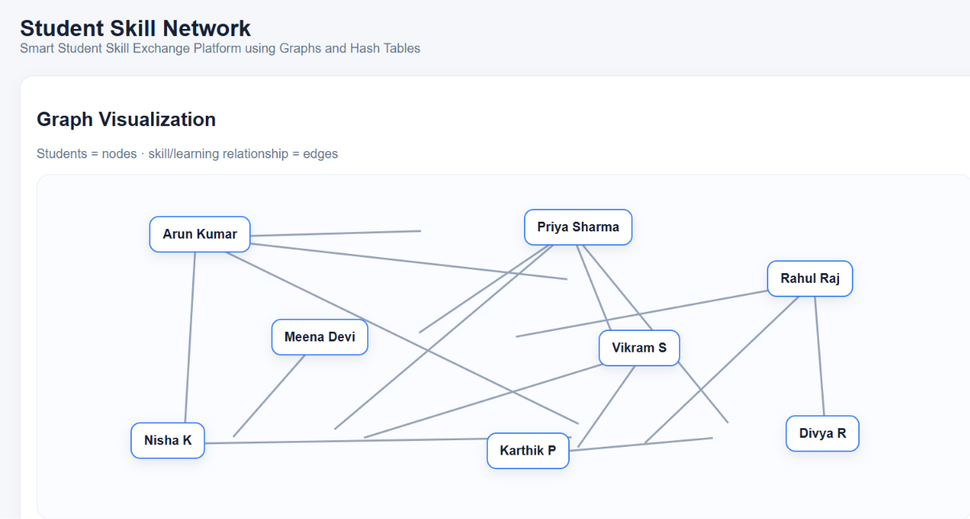
MODULE 3 – STUDENT SKILL NETWORK USING GRAPHS

Slide 15
MODULE 4 – SMART SKILL RECOMMENDATION USING GRAPHS
Function:
Recommends suitable students for skill exchange.
Analyses graph connections to find the best learning partners.
Maintains collaboration and skill exchange records.
Features:
Intelligent partner recommendation.
Personalized skill suggestions.
Tracks student collaboration history.
Outcome:
Improves skill exchange by providing accurate recommendations and encouraging effective peer learning.

Slide 16
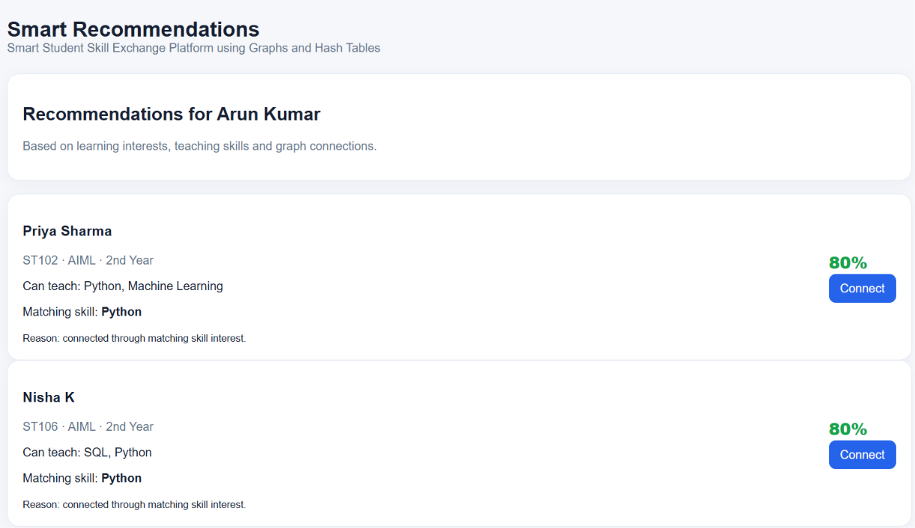
MODULE 4 – SMART SKILL RECOMMENDATION USING GRAPHS

Slide 17
CONCLUSION
The Smart Student Skill Exchange Platform Using Graphs and Hash Tables provides an efficient way for students to connect, learn, and share skills. By using Hash Tables, the system enables fast storage and retrieval of student information, while Graphs help build meaningful connections between students based on their skills and interests. The platform improves collaboration, encourages peer learning, and makes skill exchange simple and effective. Overall, the project demonstrates how data structures can be applied to solve real-world educational challenges.

Slide 18
FUTURE SCOPE
Integrate AI-based recommendations to provide more accurate skill matching.
Add real-time chat and video meeting features for better communication.
Develop a mobile application for easy access anytime and anywhere.
Introduce certificates, badges, and reward points to encourage active participation.
Expand the platform to connect students from multiple colleges and universities for wider skill exchange.

Slide 19
THANK YOU

